Slide 1


Quantum Superdense Coding
Archit Chadalawada
General Secretary
QuantUs

Slide 2
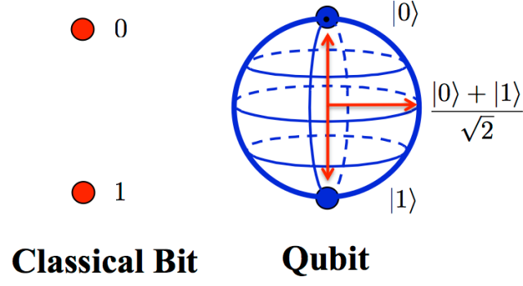


Mathematically Modelling a Qubit

Slide 3

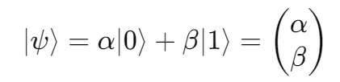
Vector and Dirac Representation

Slide 4
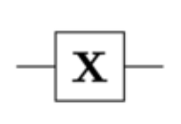
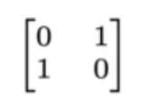
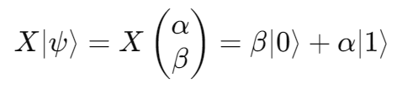
X Gate – Flips the Amplitudes
Proof + Visualization

Slide 5


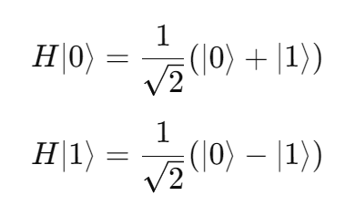
H Gate – Creates a Superposition
Proof + Visualization

Slide 6



Z Gate – Flips the Phase
Proof + Visualization

Slide 7
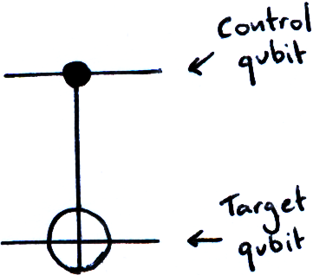
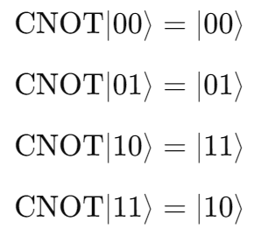
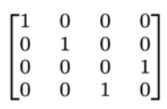
CNOT Gate – Conditionally apply X
Proof

Slide 8
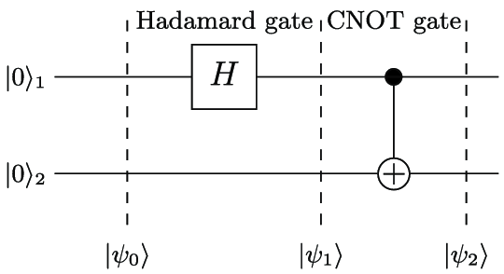
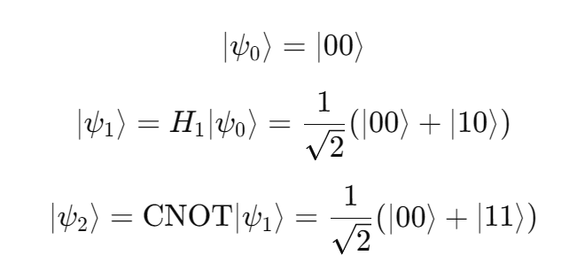
Entanglement and Bell States

Slide 9
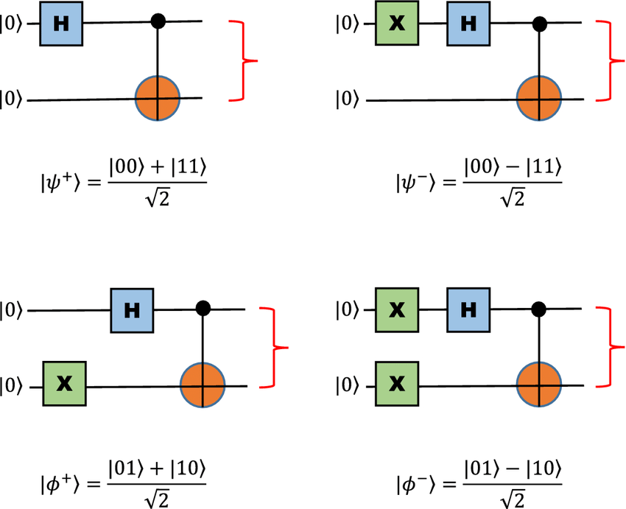
Some Other Bell States

Slide 10
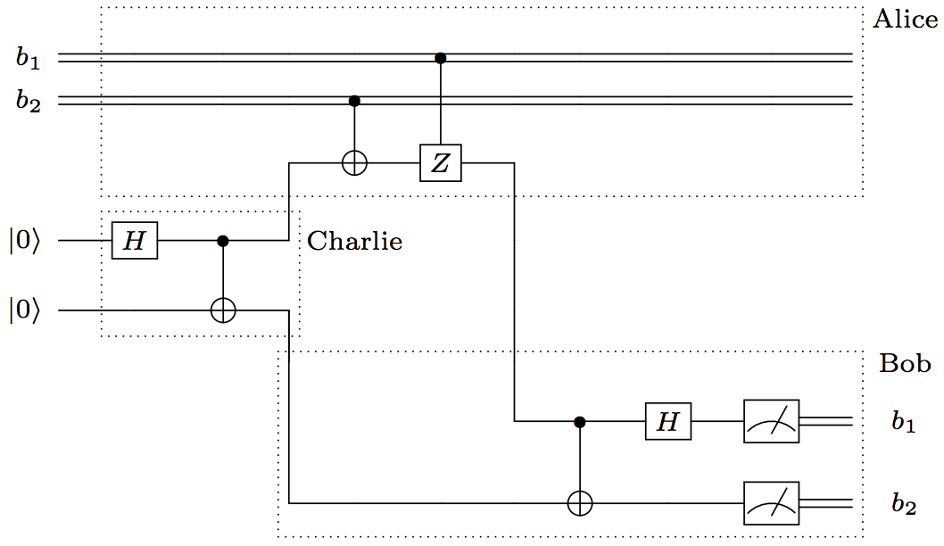
Superdense Coding

Slide 11


Proof + Qiskit Implementation

Slide 12
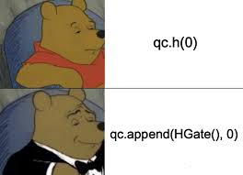
Any Questions?

